Slide 1
Mobility HTML 5
Parameswari.E

Slide 2
What is HTML5?
HTML5 is a markup language for structuring and presenting content for the World Wide Web and a core technology of the Internet.
The previous version of HTML, HTML 4.01, came in 1999. The web has changed a lot since then.
It is the fifth revision of the HTML standard (created in 1990 and standardized as HTML 4 as of 1997 and, as of December 2012, is a W3C Candidate Recommendation).

Slide 3

What is HTML5?

Slide 4
History of HTML5
It was first published as an Internet draft in 1993.
The ’90s saw an enormous amount of activity around HTML, with version 2.0, versions 3.2, and 4.0 (in the same year!), and finally, in 1999, version 4.01.
After the rapid delivery of these four versions though, HTML was widely considered a dead-end;

Slide 5
History of HTML5
Wanting to take the web platform to a new level, a small group of people started the Web Hypertext Application Working Group (WHATWG) in 2004.
They created the HTML5 specification.
The W3C became involved with HTML again in 2006 and published the first working draft for HTML5 in 2008.

Slide 6
History of HTML5
Rough Timeline of Web Technologies1991 HTML
1994 HTML 2
1996 CSS 1 + JavaScript
1997 HTML 4
1998 CSS 2
2000 XHTML 1
2002 Tableless Web Design
2005 AJAX
2008 HTML 5

Slide 7
Plan 2014
The combined timelines for HTML 5.0, HTML 5.1 and HTML 5.2:
 | 2012 | 2013 | 2014 | 2015 | 2016
HTML 5.0 | Candidate Rec | Call for Review | Recommendation
HTML 5.1 | 1st Working Draft |  | Last Call | Candidate Rec | Recommendation
HTML 5.2 |  |  |  | 1st Working Draft

Slide 8
The Myth of 2022 and Why It Doesn’t Matter
The HTML5 specification that we see today has been published as a working draft—it is not yet final.
So when does it get cast in stone?
Here are the key dates that you need to know.
The first is 2012, which is the target date for the candidate recommendation.
The second date is 2022, which is the proposed recommendation.

Slide 9
The Myth of 2022 and Why It Doesn’t Matter
 | 2012 | 2013 | 2014 | 2015 | 2016
HTML 5.0 | Candidate Rec | Call for Review | Recommendation
HTML 5.1 | 1st Working Draft |  | Last Call | Candidate Rec | Recommendation
HTML 5.2 |  |  |  | 1st Working Draft

Slide 10
Who Is Developing HTML5?
Web Hypertext Application Technology Working Group (WHATWG): Founded in 2004 by individuals working for browser vendors Apple, Mozilla, Google, and Opera, WHATWG develops HTML and APIs for web application development and provides open collaboration of browser vendors and other interested parties.
World Wide Web Consortium (W3C): The W3C contains the HTML working group that is currently charged with delivering their HTML5 specification.
Internet Engineering Task Force (IETF): This task force contains the groups responsible for Internet protocols such as HTTP. HTML5 defines a new WebSocket API that relies on a new WebSocket protocol, which is under development in an IETF working group.

Slide 11
A New Vision
HTML5 is based on various design principles, spelled out in the WHATWG specification, that truly embody a new vision of possibility and practicality.
• Compatibility
• Utility
• Interoperability
• Universal access

Slide 12
Compatibility and Paving the Cow Paths
Its core principles is to keep everything working smoothly.
If HTML5 features are not supported, the behavior must degrade gracefully.
Google analysed millions of pages to discover the common ID and Class names for DIV tags and found a huge amount of repetition.
For example, many people used DIV id="header" to mark up header content.
HTML5 is all about solving real problems, So why not simply create a <header> element?

Slide 13
Utility and the Priority of Constituencies
The HTML5 specification is written based upon a definite Priority of Constituencies
“the user is king.” the specification values users over authors, over implementers (browsers), over specifiers (W3C/WHATWG), and over theoretical purity.
As a result, HTML5 is overwhelmingly practical.

Slide 14
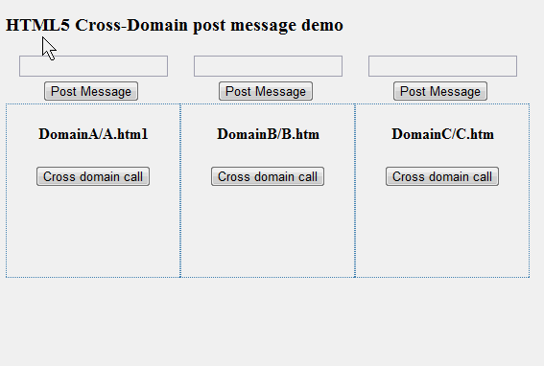
Secure by Design

Slide 15
Separation of Presentation and Content
The problems with presentational markup are:
• Poor accessibility
• Unnecessary complexity (it’s harder to read your code with all the inline styling)
• Larger document size (due to repetition of style content), which translates into slower-loading pages

Slide 16
Separation of Presentation and Content
HTML5 takes a giant step toward the clean separation of presentation and content.
HTML5 strives to create this separation wherever possible, and it does so using CSS.

Slide 17
Interoperability Simplification
HTML5 is all about simplification and avoiding needless complexity.
Native browser ability instead of complex JavaScript code(validations, Date Type etc.,)
A new, simplified DOCTYPE
A new, simplified character set declaration
Powerful yet simple HTML5 APIs

Slide 18
Universal Access
This principle is divided into three concepts:
• Accessibility: To support users with disabilities, HTML5 works closely with a related standard called Web Accessibility Initiative (WAI) Accessible Rich Internet Applications (ARIA). WAI-ARIA roles, which are supported by screen readers, can be already be added to your HTML elements.
• Media Independence: HTML5 functionality should work across all different devices and platforms if at all possible.
• Support for all world languages: For example, the new <ruby> element supports the Ruby annotations that are used in East Asian typography.

Slide 19
A Plugin–Free Paradigm
HTML5 provides native support for many features that used to be possible only with plugins or complex hacks (a native drawing API, native video, native sockets, and so on).

Slide 20

What you can do with HTML5

Slide 21
What’s In and What’s Out?
Canvas (2D and 3D)
• Cross-document messaging
• Geolocation
• Audio and Video
• Forms
• MathML
• Microdata
• Server-Sent events
• Scalable Vector Graphics (SVG)
• WebSocket API and protocol
• Web origin concept

Slide 22
What’s In and What’s Out?
Web storage
• Indexed database
• Application Cache (Offline Web Apps)
• Web Workers
• Drag and Drop

Slide 23
What’s New in HTML5?
New DOCTYPE and Character Set
HTML4
<!DOCTYPE HTML PUBLIC "-//W3C//DTD HTML 4.01 Transitional//EN"
"http://www.w3.org/TR/html4/loose.dtd">
HTML5
<!DOCTYPE html>

Slide 24
What’s New in HTML5?
New DOCTYPE and Character Set
HTML4
the character set declaration has also been abbreviated. It used to be
<meta http-equiv="Content-Type" content="text/html; charset=utf-8“>
HTML5
<meta charset="utf-8">

Slide 25
New and Deprecated Elements

Slide 26
Semantic Markup

Slide 27
Simplifying Selection Using the Selectors API

Slide 28
How Did HTML5 Get Started?
As of May 2012, the specification is back to Working Draft state at the W3C. Ian Hickson of Google is the editor of HTML5.
The criterion for the specification becoming a W3C Recommendation is "two 100% complete and fully interoperable implementations". Many parts of the specification are stable and may be implemented in products.
In July 2012, WHATWG (Web Hypertext Application Technology Working Group )and W3C have decided on a degree of separation.

Slide 29
JavaScript Logging and Debugging
The first great tool for analyzing web pages and the code running in them was the Firefox add-on, Firebug.
Safari’s Web Inspector, Google’s Chrome Developer Tools, Internet Explorer’s Developer Tools, and Opera’s Dragonfly.
Many of the debugging tools offer a way to set breakpoints to halt code execution and analyze the state of the program and the current state of the variables.
The console.log API has become the de facto logging standard for JavaScript developers.

Slide 30
window.JSON
JSON is a relatively new and increasingly popular way to represent data.
It is a subset of JavaScript syntax that represents data as object literals.
Due to its simplicity and natural fit in JavaScript programming, JSON has become the de facto standard for data interchange in HTML5 applications.
The canonical API for JSON has two functions, parse() and stringify() (meaning serialize or convert to string).

Slide 31
DOM Level 3
Internet Explorer 9 (IE9) now supports DOM Level 2 and 3 features, so you can finally use the same code for DOM manipulation and event handling in all HTML5 browsers.
This includes the ever-important addEventListener() and dispatchEvent() methods.

Slide 32
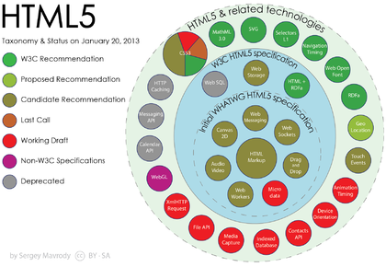
Features

Slide 33
Deprecated Elements
The following HTML 4.01 elements are removed from HTML5:
<acronym>
<applet>
<basefont>
<big>
<center>
<dir>
<font>
<frame>
<frameset>
<noframes>
<strike>
<tt>

Slide 34
HTML5 Browser Support
Chrome 10.0 was the big winner coming in at 301 points out of 400 possible.
They have already implemented most of the functionality to be a compatible HTML5 browser.
In addition, many of the features that are not added are partially added.
So Google Chrome is definitely way out in front in the race for HTML compatible browsers.

Slide 35
HTML5 Browser Support
Firefox 4.0 is next in line and they scored pretty decently getting 249 out 400 possible points.
They are still missing a lot of key elements but got bonus points for the audio and video implementation as well as their parsing rules.
Internet Explorer 8 is pretty far behind the curve.
IE scored a total of 32 points out of 400.

Slide 36
The HTML5 <!DOCTYPE>
In HTML5 there is only one <!doctype> declaration, and it is very simple:
< !DOCTYPE html>

Slide 37
Minimum HTML5 Document
<!DOCTYPE html> < html> < head> < title>Title of the document</title> < /head> < body> The content of the document...... < /body> < /html>

Slide 38
Browser Support for HTML5
HTML5 is not yet an official standard, and no browsers have full HTML5 support.
But all major browsers (Safari, Chrome, Firefox, Opera, Internet Explorer) continue to add new HTML5 features to their latest versions.

Slide 39
Using the Canvas API

Slide 40
Overview of HTML5 Canvas
The canvas concept was originally introduced by Apple to be used in Mac OS X WebKit to create dashboard widgets.
Before the arrival of canvas, you could only use drawing APIs in a browser through plug-ins such as Adobe plug-ins for Flash and Scalable Vector Graphics (SVG), Vector Markup Language (VML) only in Internet Explorer, or other clever JavaScript hacks.

Slide 41
What Is a Canvas?
When you use a canvas element in your web page, it creates a rectangular area on the page.
By default, this rectangular area is 300 pixels wide and 150 pixels high, but you can specify the exact size and set other attributes for your canvas element.
A Basic Canvas Element
<canvas></canvas>

Slide 42
Canvas Coordinates

Slide 43
When Not to Use Canvas
Although the canvas element is great and very useful, you should not use the canvas element when another element will suffice.
For example, it would not be a good idea to dynamically draw all the different headings for an HTML document on a canvas instead of simply using heading styles (H1, H2, and so on) that are meant for that purpose.

Slide 44
Fallback Content
In case your web page is accessed by a browser that does not support the canvas element or a subset of the Canvas API features, it is a good idea to provide an alternate source.
For example, you can provide an alternate image or just some text that explains what the user could be enjoying if they actually used a modern browser.
<canvas>
Update your browser to enjoy canvas!
</canvas>

Slide 45
CSS and Canvas
As with most HTML elements, CSS can be applied to the canvas element itself to add borders, padding, margins, etc.
Additionally, some CSS values are inherited by the contents of the canvas; fonts are a good example.

Slide 46
Browser Support for HTML5 Canvas
With the arrival of Internet Explorer 9, all browser vendors now provide support for HTML5 Canvas, and it is already in the hands of a majority of users.
This is a major milestone in web development, allowing 2D drawing to thrive on the modern Web.

Slide 47
Using the HTML5 Canvas APIs
ctx.fillRect(Xstart,Ystart,Width,Height);
strokeRect(Xstart,Ystart,Width,Height) – To draw a rectangular outline (No fill)
clearRect(Xstart,Ystart,Width,Height) : To clear the specified rectangle making it fully transparent

Slide 48
Canvas Paths
beginPath()
closePath()
stroke()
fill()
ctx.beginPath();
ctx.moveTo(50, 50);
ctx.lineTo(200, 200);
ctx.closePath();
ctx.stroke();

Slide 49
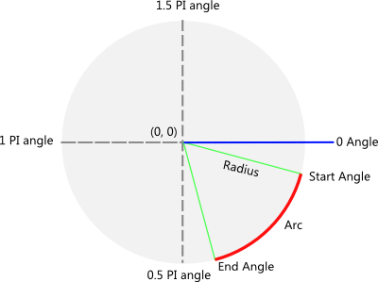
Drawing a circle in canvas

Slide 50
Drawing a circle in canvas
arc(x, y, radius, stratAngle, endAngle, anticlockwise)

Slide 51
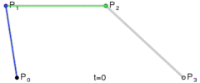
Drawing Curves on HTML5 Canvas

Slide 52
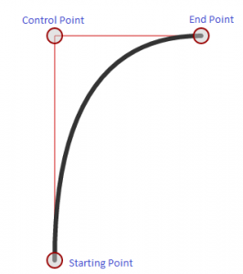
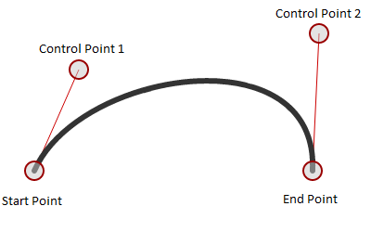
Drawing Curves on HTML5 Canvas

Slide 53
Colors in HTML5 canvas
ctx.fillStyle = “red”;
ctx.fillStyle = “#FF0000″;
ctx.fillStyle = “rgb(255,0,0)”;
ctx.fillStyle = “rgba(255,0,0,1)”;

Slide 54
Font and Text in Canvas
fillText(text, x, y)
text – Any string you wish to display in your canvas
x, y - Co-ordinates of the starting point of text

Slide 55
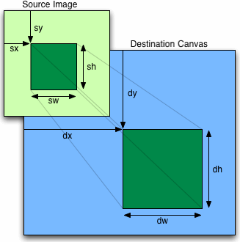
Using the HTML5 Canvas APIs

Slide 56
Using the HTML5 Canvas APIs
<canvas id="e" width="177" height="113">
</canvas>
<script>
var canvas = document.getElementById("e");
var context = canvas.getContext("2d");
var cat = new Image();
cat.src = "images/cat.png";
cat.onload = function()
{for (var x = 0, y = 0; x < 500 && y < 375;
x += 50, y += 37)
{ context.drawImage(cat, x, y, 88, 56); } };
</script>

Slide 57
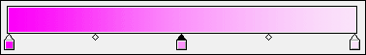
Canvas Gradients
Gradient
Definition
Gradients consist of continuously smooth color transitions along a vector from one color to another, possibly followed by additional transitions along the same vector to other colors.

Slide 58
Canvas Gradients
Linear gradient : A linear gradient defines color change along a line between two points.
Syntax :
var gradient = ctx.createLinearGradient(x0, y0, x1, y1);
x0 - The x-coordinate (in pixels), of the start point of the gradient.
y0 - The y-coordinate (in pixels), of the start point of the gradient.
x1 - The x-coordinate (in pixels), of the end point of the gradient.
y1 - number The y-coordinate (in pixels), of the end point of the gradient

Slide 59
Canvas Gradients
addColorStop(offset, color) This method adds a color stop with the given color to the gradient at the given offset. Here 0.0 is the offset at one end of the gradient, 1.0 is the offset at the other end.
createRadialGradient(x0, y0, r0, x1, y1, r1) This method returns a CanvasGradient object that represents a radial gradient that paints along the cone given by the circles represented by the arguments.
The first three arguments define a circle with coordinates (x1,y1) and radius r1 and the second a circle with coordinates (x2,y2) and radius r2.

Slide 60
HTML5 Inline SVG
SVG stands for Scalable Vector Graphics
SVG is used to define vector-based graphics for the Web
SVG defines the graphics in XML format
SVG graphics do NOT lose any quality if they are zoomed or resized
Every element and every attribute in SVG files can be animated
SVG is a W3C recommendation

Slide 61
SVG Advantages
Advantages of using SVG over other image formats (like JPEG and GIF) are:
SVG images can be created and edited with any text editor
SVG images can be searched, indexed, scripted, and compressed
SVG images are scalable
SVG images can be printed with high quality at any resolution
SVG images are zoomable (and the image can be zoomed without degradation)

Slide 62
Comparison of Canvas and SVG
Canvas | SVG
Resolution dependent No support for event handlers Poor text rendering capabilities You can save the resulting image as .png or .jpg Best suited for graphic-intensive games where many objects are redrawn frequently | Resolution independent Support for event handlers Best suited for applications with large rendering areas (Google Maps) Slow rendering if complex (anything that uses the DOM a lot will be slow) Not suited for game applications

Slide 63
Performance of Canvas versus SVG
Canvas | SVG
Pixel based (Dynamic .png) | Shape based
Single HTML element | Multiple graphical elements, which become part of the DOM
Modified through script only | Modified through script and CSS
Event model/user interaction is granular (x,y) | Event model/user interaction is abstracted (rect, path)
Performance is better with smaller surface, a larger number of objects (>10k), or both | Performance is better with smaller number of objects (<10k), a larger surface, or both

Slide 64
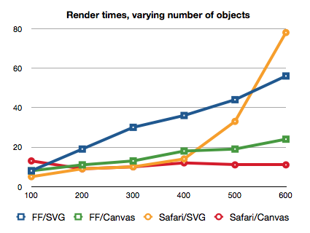
Performance of Canvas versus SVG

Slide 65
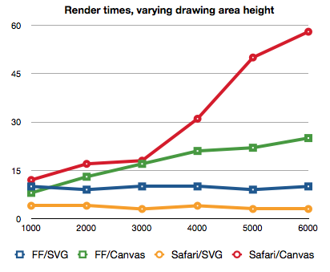
Performance of Canvas versus SVG

Slide 66
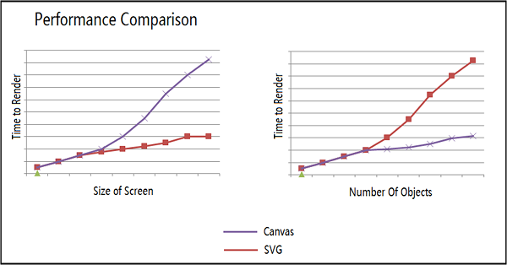
Performance of Canvas versus SVG

Slide 67
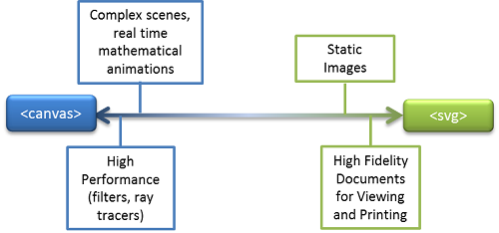
Performance of Canvas versus SVG

Slide 68
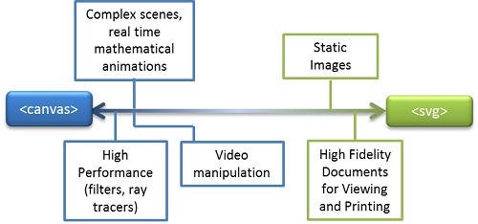
Performance of Canvas versus SVG

Slide 69
Learning and reusing SVG
<svg xmlns="http://www.w3.org/2000/svg"> <circle id="greencircle" cx="30" cy="30" r="30" fill="green" /> </svg>

Slide 70
Creating basic shapes
Element | Description
line | Creates a simple line.
polyline | Defines shapes built from multiple line definitions.
rect | Creates a rectangle.
circle | Creates a circle.
ellipse | Creates an ellipse.
polygon | Creates a polygon.
path | Allows for the definition of arbitrary paths.

Slide 71
Add the SVG Element
<svg version="1.1"
baseProfile="full"
xmlns="http://www.w3.org/2000/svg"
height="100%" width="100%">
</svg>

Slide 72
Create the Definitions
<defs>
<linearGradient id="labelGrad1" x1="0%" y1="0%" x2="100%" y2="0%">
<stop offset="0%" style="stop-color:#990000; stop-opacity:1" />
<stop offset="20%" style="stop-color:#ff6600; stop-opacity:1" />
<stop offset="40%" style="stop-color:#cccc00; stop-opacity:1" />
<stop offset="60%" style="stop-color:#009900; stop-opacity:1" />
<stop offset="80%" style="stop-color:#000099; stop-opacity:1" />
<stop offset="100%" style="stop-color:#990099; stop-opacity:1" />
</linearGradient>
</defs>
<rect width="90%" height="90%" x="5%" y="5%" fill="url(# labelGrad1)" />

Slide 73
Create the Definitions
<defs>
<radialGradient id="recordGrad" cx="50%" cy="50%" r="50%" fx="50%" fy="50%">
<stop offset="30%" style="stop-color:#000000; stop-opacity:1" />
<stop offset="35%" style="stop-color:#222222; stop-opacity:1" />
<stop offset="45%" style="stop-color:#000000; stop-opacity:1" />
<stop offset="85%" style="stop-color:#000000; stop-opacity:1" />
<stop offset="95%" style="stop-color:#222222; stop-opacity:1" />
<stop offset="100%" style="stop-color:#000000; stop-opacity:1" />
</radialGradient>
</defs>
<circle cx="50%" cy="50%" r="33%" fill="#000000" filter="url(#ecordGrad)" />

Slide 74
SVG Logo
<svg height="130" width="500">
<defs>
<linearGradient id="grad1" x1="0%" y1="0%" x2="100%" y2="0%">
<stop offset="0%" style="stop-color:rgb(255,180,0);stop-opacity:1" />
<stop offset="100%" style="stop-color:rgb(255,150,0);stop-opacity:1" />
</linearGradient>
</defs>
<ellipse cx="100" cy="70" rx="85" ry="55" fill="url(#grad1)" />
<text fill="#ffffff" font-size="45" font-family="Verdana" x="30" y="86">Home</text>
Sorry, your browser does not support inline SVG.
</svg>

Slide 75
SVG Logo
<svg height="150" width="500"> <ellipse cx="240" cy="100" rx="220" ry="30" style="fill:purple" /> <ellipse cx="220" cy="70" rx="190" ry="20" style="fill:lime" /> <ellipse cx="210" cy="45" rx="170" ry="15" style="fill:yellow" /> </svg>

Slide 76
SVG Stroke Properties
stroke
stroke-width
stroke-linecap
stroke-dasharray

Slide 77
G Element
The g element is a container used to group objects.
Transformations applied to the g element are performed on all of its child elements.
Attributes applied are inherited by child elements.

Slide 78
SVG <path>
SVG Path - <path>
The <path> element is used to define a path.
The following commands are available for path data:
M = moveto
L = lineto
H = horizontal lineto
V = vertical lineto
C = curveto
S = smooth curveto
Q = quadratic Bézier curve
T = smooth quadratic Bézier curveto
A = elliptical Arc
Z = closepath

Slide 79
SVG Stroke
<svg height="80" width="300">
<g fill="none">
<path stroke="red" d="M5 20 l215 0" />
<path stroke="blue" d="M5 40 l215 0" />
<path stroke="black" d="M5 60 l215 0" />
</g>
</svg>

Slide 80
SVG Stroke Width
<svg height="80" width="300">
<g fill="none" stroke="black">
<path stroke-width="2" d="M5 20 l215 0" />
<path stroke-width="4" d="M5 40 l215 0" />
<path stroke-width="6" d="M5 60 l215 0" />
</g>
</svg>

Slide 81
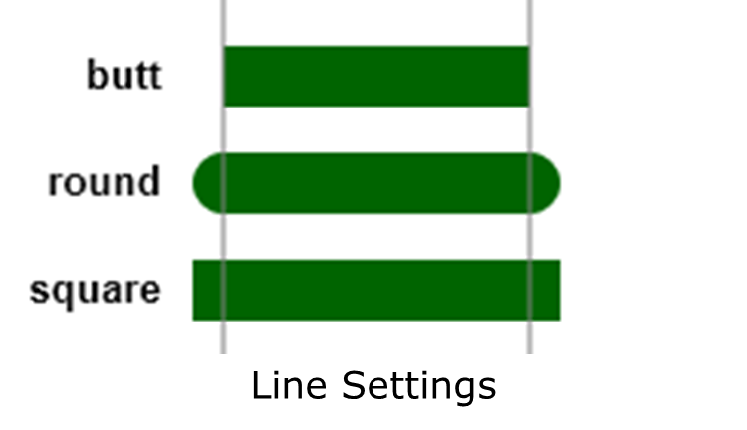
Applying Styles

Slide 82
SVG Stroke Line Cap
<svg height="80" width="300">
<g fill="none" stroke="black" stroke-width="6">
<path stroke-linecap="butt" d="M5 20 l215 0" />
<path stroke-linecap="round" d="M5 40 l215 0" />
<path stroke-linecap="square" d="M5 60 l215 0" />
</g>
</svg>

Slide 83
SVG Stroke Dash Array
<svg height="80" width="300">
<g fill="none" stroke="black" stroke-width="4">
<path stroke-dasharray="5,5" d="M5 20 l215 0" />
<path stroke-dasharray="10,10" d="M5 40 l215 0" />
<path stroke-dasharray="20,10,5,5,5,10" d="M5 60 l215 0" />
</g>
</svg>

Slide 84
SVG Rounded Rectangle
<svg width="400" height="180"> <rect x="50" y="20" rx="20" ry="20" width="150" height="150" style="fill:red;stroke:black;stroke-width:5;opacity:0.5" /> </svg>

Slide 85
SVG Line
<svg xmlns="http://www.w3.org/2000/svg" version="1.1" height="800">
<line x1="100" y1="100" x2="400" y2="100" style="stroke:rgb(255,0,0);stroke-width:4" ></line>
</svg>

Slide 86
SVG Polygon
<svg height="210" width="500">
<polygon points="200,100 500,100 300 200" style="fill:lime;stroke:purple;stroke-width:1" />
</svg>

Slide 87
SVG <path>
<svg height="210" width="400"> <path d="M150 0 L75 200 L225 200 Z" /> </svg>

Slide 88
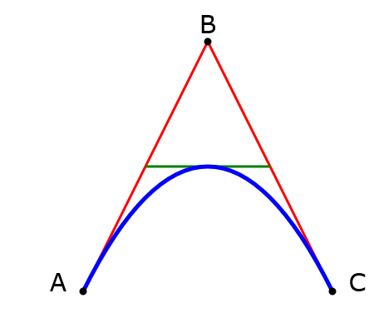
SVG <path>

Slide 89
SVG <path>
<path id="lineAB" d="M 100 350 l 150 -300" stroke="red" stroke-width="3" fill="none" />
<path id="lineBC" d="M 250 50 l 150 300" stroke="red" stroke-width="3" fill="none" />
<path d="M 175 200 l 150 0" stroke="green" stroke-width="3" fill="none" />

Slide 90
SVG <path> Quad Curve
<svg height="400" width="450">
<path d="M 100 350 q 150 - 300 300 0" stroke="blue"
stroke-width="5" fill="none" />

Slide 91
SVG <text>
<svg height="60" width="200"> <text x="0" y="15" fill="red" transform="rotate(30 20,40)">Welcome</text> </svg>

Slide 92
SVG Animations
SVG graphics can be animated using animation elements.
<animate> - which allows you to animate scalar attributes and properties over a period of time.
<set> - which is a convenient shorthand for animate, which is useful for assigning animation values to non-numeric attributes and properties, such as the visibility property.
<animateMotion> - which moves an element along a motion path.
<animateColor> - which modifies the color value of particular attributes or properties over time.

Slide 93
The SVG extensions
<animateTransform> - allows you to animate one of SVG's transformation attributes over time, such as the transform attribute.
path (attribute) - allows any feature from SVG's path data syntax to be specified in a path attribute to the animateMotion element.
<mpath> - used in conjunction with the animateMotion element to reference a motion path that is to be used as a path for the motion.

Slide 94
The SVG extensions
keypoints (attribute) - used as an attribute for animateMotion to provide precise control of the velocity of motion path animations.
rotate (attribute) - used as an attribute for animateMotion to control whether an object is automatically rotated so that its x-axis points in the same direction as the directional tangent vector of the motion path.

Slide 95
SVG animate- Height
<svg>
<rect width="200" height="200" fill="slategrey">
<animate attributeName="height" from="0" to="200" dur="3s"/>
</rect>
</svg>

Slide 96
SVG animate- Radius
<svg>
<circle r="50" cx="350" cy="100" fill="slategrey">
<animate attributeName="r" from="0" to="50" dur="3s"/>
</circle></svg>

Slide 97
SVG animate- Movement
<svg>
<rect x="0" y="250" width="200" height="200" fill="slategrey">
<animate attributeName="x" from="0" to="200" dur="3s" fill="freeze"/>
</rect></svg>

Slide 98
SVG animate- Multiple
<circle r="50" cx="500" cy="100" fill="slategrey" stroke="#000" stroke-width="7">
<animate attributeName="r" from="0" to="50" dur="3s"/>
<animate attributeName="stroke-width" from="0" to="20" dur="7s"/>
</circle>

Slide 99
New Media Elements
Tag | Description
<audio> | Defines sound content
<video> | Defines a video or movie
<source> | Defines multiple media resources for <video> and <audio>
<embed> | Defines a container for an external application or interactive content (a plug-in)
<track> | Defines text tracks for <video> and <audio>

Slide 100
HTML5 <video> - Methods, Properties, and Events
Methods | Properties | Events
play() | currentSrc | play
pause() | currentTime | pause
load() | videoWidth | progress
canPlayType | videoHeight | error
 | duration | timeupdate
 | ended | ended
 | error | abort
 | paused | empty
 | muted | emptied
 | seeking | waiting
 | volume | loadedmetadata
 | height
 | width

Slide 101
Poster Attribute
<video controls poster="/images/w3html5.gif"> <source src="movie.mp4" type="video/mp4"> <source src="movie.ogg" type="video/ogg"> Your browser does not support the video tag. </video>

Slide 102
Video Element Support
<video> element support
IE | Firefox | Safari | Chrome | Opera | iPhone | Android
9.0+ | 3.5+ | 3.0+ | 3.0+ | 10.5+ | 1.0+ | 2.0+

Slide 103
Browser Support CODECS
 | Android | Chrome |  | Firefox |  | Internet Explorer | iOS | Opera |  | Safari
Codec |  | Win | Mac | Win | Mac | Win |  | Win | Mac | Win | Mac
MP4 or H.264 | 3.0 | 9 | 7 | X | X | 9 | 3 | X | X | 5 | 5
ogg/Theora | 2.3 | 9 | 7 | 3.6 | 3.6 | X | X | 10.63 | 10.63 | X | X
WebM | 2.3 | 9 | 7 | 3.6 | 3.6 | 9 (with components) | X | 10.63 | 10.63 | X | X

Slide 104
Browser Support CODECS
Video | IE8 | IE9+ | Chrome | Safari | Mobile | Firefox | Opera
MP4 (h.264/AAC) | no | yes | yes | yes | yes | no | no
WebM (VP8/Vorbis) | no | install | yes | no | no | yes | yes

Slide 105
Video-Specific Attributes
The video element can be laid out easily by using CSS
The width and height attributes specify the dimensions of the viewing area
The video always maintains its innate aspect ratio
The poster frame image is shown before the video is played
<video src="video.m4v" poster="first_frame.png" width=”100px” height=”100px”></video>

Slide 106
Alternative Sources
The source element specifies alternate media resources
Multiple source elements can be specified
The browser uses only the first source element it supports
Specifying the MIME type with the type attribute avoids downloading unsupported files
The media attribute constrains the environment by using media queries
video>
<source src="video.m4v" " type="video/mp4" />
</video>
<audio>
<source src="audio.m4a" " type="video/mp4" />
</audio>

Slide 107
Integrating Text
The track element associates timed text with a video
The standard text track file formats are WebVTT and TTML
The kind attribute specifies the role of the text track
The srclang attribute specifies the text track’s language
Subtitle, caption, and description tracks are listed by using their label attribute
The track marked with the default attribute is automatically selected on load
<video src="video.m4v">
<track src="video.vtt" />
</video>

Slide 108
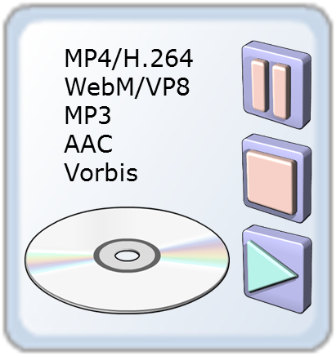
Video and Audio Formats
Format | IE | Firefox | Opera | Chrome | Safari
Ogg | No | Yes | Yes | Yes | No
MP3 | Yes | No | No | Yes | Yes
Wav | No | Yes | Yes | Yes | Yes

Slide 109
Controlling Playback
The play method starts playback
The pause method pauses playback
The playbackRate property changes the playback speed
The currentTime property reports the current position and seeks
The duration property reports the length of the video or audio
The buffered property lists the currently downloaded data
Many properties and events report status and progress
var video = document.getElementById("video");
video.play();
window.setTimeout(function () {
video.pause();
}, 3000);

Slide 110
Optimizing Playback
Optimizing playback is important for improving performance and user experience
The Media API provides many tools for optimizing playback
The readyState property and its associated events report on the media’s current state
Different events report different reasons media stops downloading or playing
if (audio.readyState === audio.HAVE_ENOUGH_DATA) {
audio.playbackRate = 1; // play at the normal rate
{
else if (audio.readyState >= audio.HAVE_CURRENT_DATA) {
audio.playbackRate = 0.8; // slow the playback down a bit to give the browser an opportunity to "catch up"
{

Slide 111
Integrating Video and the Canvas
Video uses time, and the canvas does not
Time loops are used to simulate time
The setInterval and setTimeout methods drive the time loop
The Video and Canvas APIs work well together
function frame() {
var context = document.getElementyId("canvas").getContext("2d");
var video = document.getElementById("video");
context.drawImage(video, 0, 0);
window.setTimeout(frame, 100);
}
frame(); // calling the function directly triggers the first iteration

Slide 112
HTML5 Audio
<audio controls="controls"> <source src="horse.ogg" type="audio/ogg" /> <source src="horse.mp3" type="audio/mpeg" /> Your browser does not support the audio element. </audio>

Slide 113
HTML5 Audio
Audio Formats and Browser Support
Currently, there are 3 supported file formats for the <audio> element: MP3, Wav, and Ogg:
Browser | MP3 | Wav | Ogg
Internet Explorer 9 | YES | NO | NO
Firefox 4.0 | NO | YES | YES
Google Chrome 6 | YES | YES | YES
Apple Safari 5 | YES | YES | NO
Opera 10.6 | NO | YES | YES

Slide 114
HTML5 Audio Tags
Tag | Description
<audio> | Defines sound content
<source> | Defines multiple media resources for media elements, such as <video> and < audio>

Slide 115
Media Elements and Global Attributes
accesskey
class
contenteditable
contextmenu
dir
draggable
dropzone
hidden
id
Spellcheck
tabindex
title
data-*

Slide 116
Video-Only Attributes and Video Resolutions
poster
width, height

Slide 117
Audio and Video in Mobile Devices and Media Profiles
Apple has been a big fan of HTML5 from the beginning, deciding against support for Flash on iOS devices in favor of HTML5 video.
However, some things that work on the desktop don’t in an Apple mobile environment.
As an example, using the poster attribute caused the video element to fail in iOS 3, though this problem has been fixed in iOS 4.

Slide 118
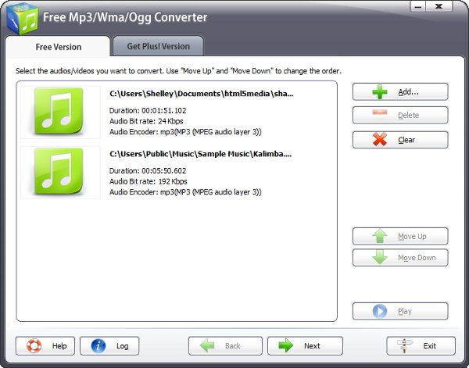
Converting Audio and Video Content
The Free Mp3/Wma/Ogg Converter

Slide 119
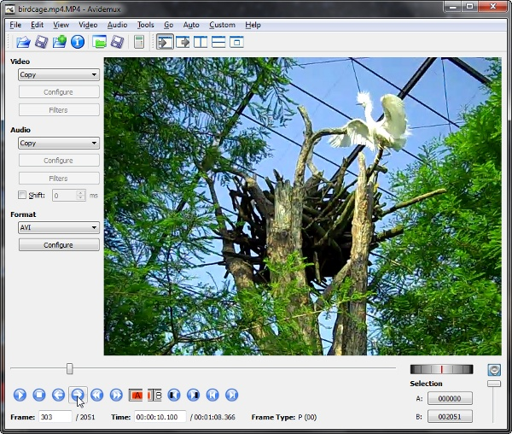
Converting Audio and Video Content
Using a Frame Grabber

Slide 120
Getting started with the HTML5 track element
The track element provides a simple, standardized way to add subtitles, captions, screen reader descriptions and chapters to video and audio.

Slide 121
Summary
Introduced some of the most exciting features in HTML5. The multimedia elements—video and audio
Many accessibility features.
Understanding APIs that programmers can use to control
multimedia.

Slide 122
New Elements in HTML5
HTML5 includes new elements for better structure, drawing, media content and better form handling
New media elements like <audio>, <video>,<source>
Canvas element <canvas> uses JavaScript to make drawing on a web page
The Input elements type attribute has many new values, for better input control before sending it to the server
Notes:
122

Slide 123
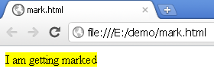
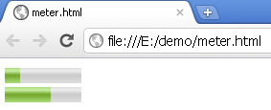
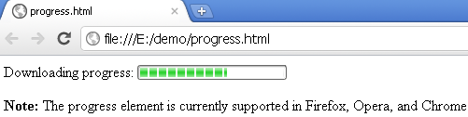
Some new markup elements
<article> | Used to specify a news-article, blog post, forum post, or other articles which can be distributed independently from the rest of the site
<mark> | For text that should be highlighted
<meter> | For a measurement, used only if the maximum and minimum values are known
<progress> | The <progress> tag represents the progress of a task
Notes:
<mark>I am getting marked</mark>
<meter value="2" min="0" max="10">2 out of 10</meter><br />
<meter value="0.6" min="0" max="1">60%</meter>
Downloading progress:
<progress value="62" max="100">
</progress>

Slide 124
Summary
At the end of this sub module:
Understand HTML 5
Different browser support for HTML 5
Different HTML 5 elements

Slide 125
HTML 5 Structural Elements

Slide 126
Objectives
Explain the rationale behind the new HTML5 elements:
Describe where and how to use the new HTML5 structural elements
Describe what are the new semantic block-level elements
Describe what are the new inline semantic elements
Describe what are the new interactive elements

Slide 127
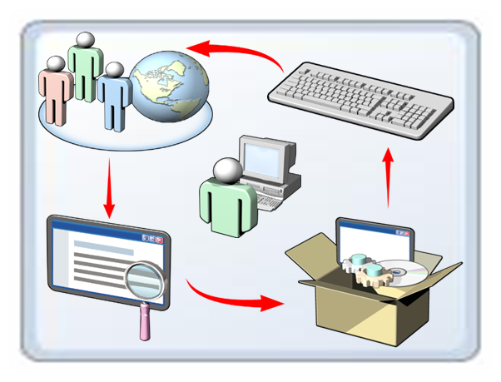
New HTML 5 – Rationale Behind
New HTML5 elements enable:
Accessibility
Searchability
Internationalization
Interoperability
Notes:
To understand why W3C created so many new HTML elements, we need to understand the World Wide Web. The World Wide Web is a collection of billions of websites and applications. Every website or application is made of textual and/or media content. In the past, to lay out a webpage, developers created
container elements (mostly div elements) and repeated some patterns in creating these containers. For example, searching inside the source code of some websites might reveal that most of them have a div element with a header id or class name. HTML5 introduces the header element to replace the way developers wrote webpages in the past. Like the header, a lot of other semantic elements were added to the HTML5 specification. These elements aren’t merely nice to have–they should be used whenever possible. The problem with that is that when the browser encounters an element that it does not recognize, the element simply won’t be rendered. The problem can be solved by using CSS or external

Slide 128
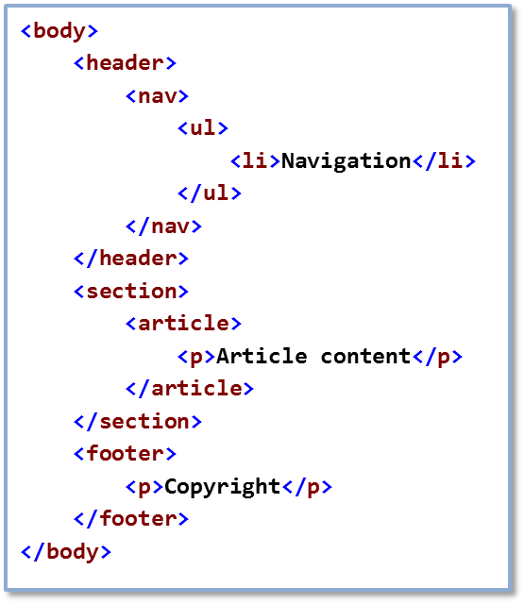
The New Structural Elements
New structural HTML5 elements:
Article
Footer
Header
Hgroup
Section
Address
Nav
Aside
No need for div elements all over the webpage
Notes:
In previous versions of HTML, developers mostly used div elements to create structural elements in their webpages. Even though the use of div remains a valid way to structure a webpage, HTML5 introduces new structural elements that can play a more effective role. These new structural elements should be implemented in new webpages and applications, and even incorporated into already-existing ones. The elements help organize the content in a more coherent way, make the code more readable, and make the webpage more accessible. The main structural elements are the following:
Article. Represented by the <article> tag. This element defines a self-contained composition. Articles are mostly used to present article content, such as blog entries, magazine articles, user comments, interactive widgets and gadgets, and any other type of independent content. Footer. Represented by the <footer> tag. This element contains information about its containing element: its author, copyright information, and so on. Footers should be used at the lowermost part of a section or webpage. A webpage can have more than one footer element. Header. Represented by the <header> tag. This element represents a group of introductory or navigation aids. Headers hold headings; navigation links and buttons; tables of contents, logos; and more.

Slide 129
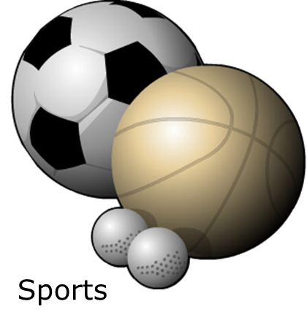
Semantic Block-Level Elements
Semantic Block-Level Elements
Block elements that have a specific semantic meaning
Include the figure element
<figure>
<img src="imageurl" alt="image alt">
<figcaption>Sports</figcaption>
</figure>

Slide 130
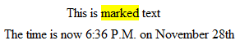
Inline Semantic Elements
Inline elements affect their content.
Examples:
Mark
Meter
Progress
Output
Time
This is <mark>marked</mark> text
<meter value="70" min="0" max="100" low="54" high="100" optimum="100">70</meter>
Your download is <progress max="100" value="60">60%</progress> complete
Output: <input type="text" value="1" /> + <input type="text" value="3" /> = <output>4</output>
The time is now <time datetime="2011-09-28T18:36">6:36 P.M. on November 28th</time>

Slide 131
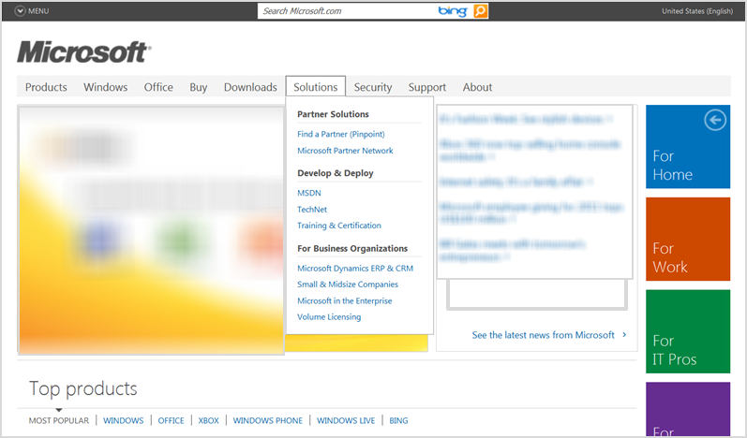
Interactive Elements
Interactive elements include:
Details
Summary
Menu
Command
<details>
<summary>The summary</summary>
<p>Some details</p>
</details>
Notes:
The <details> and <summary> Elements
The details and summary elements are designed to work together. The purpose of the detailselement is to allow developers to hide text that may be relevant to a topic but not necessarily important. This allows developers greater control over what content initially appears to the viewer which is especially useful when there is a great deal of content and limited screen space.

Slide 132
Navigation and Menus
Navigation Challenges
The nav Element
The menu Element
Notes:
The two most fundamental goals of the World Wide Web are to make it easy to publish content and to link related content. HTML is used as the publishing format, and anchor (<a>) tags are used to create links. When users go anywhere on the web, they do so by following links, going from one piece of information to another. However, the web has grown tremendously since its beginning.
The amount of content, and with it the number of links, has grown exponentially. Organizing all these links has become quite a challenge.
The use of HTML is no longer reserved for traditional websites alone. HTML is also used to build robust and highly interactive web applications that look and behave very much like desktop applications. More and more frameworks make use of HTML in desktop applications, such as Windows 8 Metro-style applications.
Such applications have often used links and buttons interchangeably, similar to how toolbars and context menus work in regular desktop applications. However, there has been no standard or consensus on how to create these menus in web applications, no common mechanism for interacting directly with the browser, and no way to distinguish between links used to connect related information and links used as
actions or commands.

Slide 133
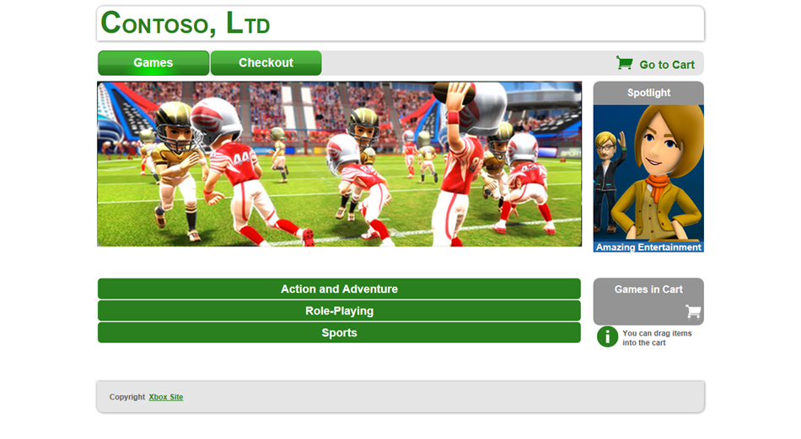
Navigation Challenges
Anchor tags all look the same
Navigation systems have been mostly visual:
Relying on visual information hurts accessibility
Search engines cannot interpret visual information
Differentiating between links and commands can be difficult

Slide 134
nav Element
The nav element:
is a semantic element
is a container for a navigation area
is designed to help search engines and screen readers
Is used for:
document navigation, when placed inside an article element
site navigation, anywhere else
<nav>
<ul>
<li><a href="/">Home</a></li>
<li><a href="/products">Products</a></li>
<li><a href="/about">Meet the Team</a></li>
</ul>
</nav>

Slide 135
The menu Element
The menu element:
contains commands
can be a toolbar or a content menu
is designed for browser integration
can be nested
Almost any element can be used as a command
<menu>
<button id="searchButton">Search</button>
<button id="helpButton">Help</button>
</menu>

Slide 136
Summary
In the module, you learned about:
The new HTML5 elements and the rationale behind the
creation of these elements.
How and when to use them.
The use of navigation and menus.

Slide 137
Creating Form Input and Validation

Slide 138
Objectives
At the end of this sub-module you will know:
HTML 5 new Input types
HTML 5 new form elements
HTML 5 new form attributes
Using Browser Detection, Feature Detection, and Modernizr

Slide 139
Challenges with HTML 4.0 Forms
The HTML 4 form fields are not validated
The validation to the input fields can be done by
Writing JavaScript code in the Client side Code
Or the validation needs to be done at the Server side
Almost every web page has some kind of form with search, email, sign-up etc
It would be great if browsers had built in validation for some of the common data types we collect
Notes:
139
139

Slide 140
HTML – New Input types
HTML 5 has lot of new input types
These new features allow for better input control and validation
email
url
number
range
Date pickers (date, month, week, time, datetime-local)
search
color
Notes:
140
140

Slide 141
Input type - email
It represents a control for editing a list of e-mail addresses given in the element’s value
HTML email address validation will only work in browsers which have support for it
<input type="email" placeholder="Please enter your email" required multiple=“multiple”>
required - specifies that the element is a required part of form submission
placeholder - a short phrase to help the user when entering data into the control
multiple - specifies that the element allows multiple values
Notes:
<!DOCTYPE html>
<html lang="en">
<head>
<title>Input-Email</title>
</head>
<body>
<form>
<input type="email" placeholder="Please enter your email" required multiple="multiple">
<input type="submit">
</form>
</body>
</html>
141

Slide 142
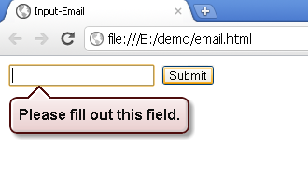
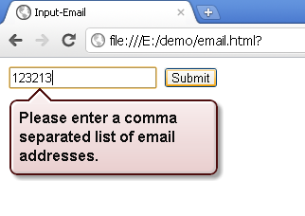
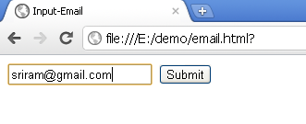
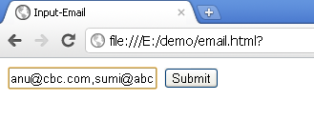
Input type – email (Contd.).
Field is empty
The value should be an email
Valid email – with a single email
Valid-More than 1 email
Notes:
142
142

Slide 143
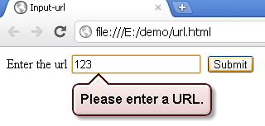
Input type - url
<input type="url" name="URL">
It is used for input fields that should contain a URL address
The value of the url field is automatically validated when the form is submitted

Slide 144
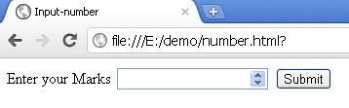
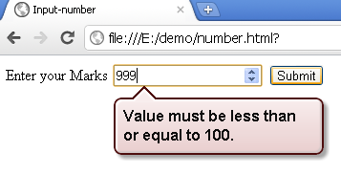
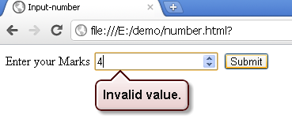
Input type - number
<input type="number" min="0" max="100">
Used to take a number as input
<input type="number" min="0 " max="100" step="3">
step - specifies legal number intervals (if step="3", legal numbers could be -3,0,3,6, etc)
Notes:
144

Slide 145
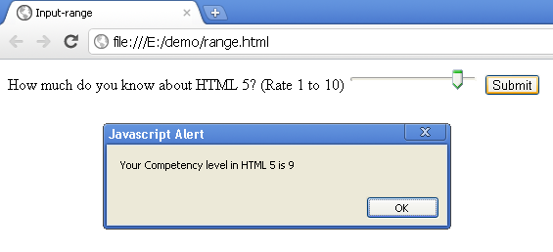
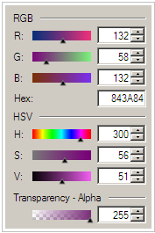
Input type - range
Slider control is a very useful user interface to set a number within a range
<input type="range" name="Range" min="1" max="10" required>
Notes:
145

Slide 146
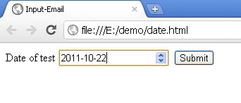
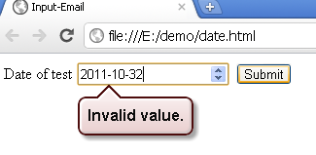
Input type – Date pickers - date
Date and time field can be easily found in many web forms
Typical applications are like ticket booking, appointment booking etc
HTML5 the web browser ensures user can only enter a valid date time string into the input textbox
<input type="date" name="set_date" />
Notes:
146
146

Slide 147
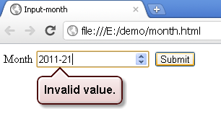
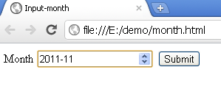
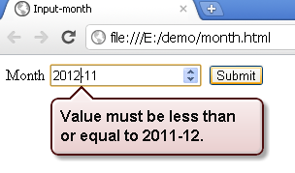
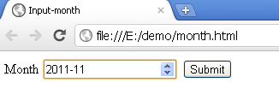
Input type – Date pickers – date (Contd.).
<input type="month" name="month" />
Creates a date input control for specifying a particular month in a year
<input type="month" name="month" min="2011-1" max="2011-12"/>
Notes:
min = month
The expected lower bound for the element’s value
The following parts, in exactly the following order:
Four or more digits representing a number greater than 0.
The literal string "-".
Two digits, representing the month month, in the range 1 ≤ month, ≤ 12.
Example:
2011-01
max = month
The expected upper bound for the element’s value
The following parts, in exactly the following order:
Four or more digits representing a number greater than 0.
The literal string "-".
Two digits, representing the month month, in the range 1 ≤ month, ≤ 12.
Example:
2011-12
147
147

Slide 148
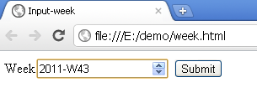
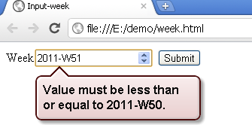
Input type – Date pickers – week
<input type="week" name="week" min="2011-W15" max="2011-W50"/>
Allows entry and validation of a week number
Notes:
148
148

Slide 149
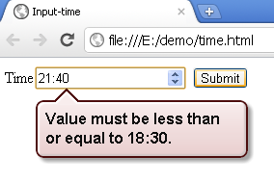
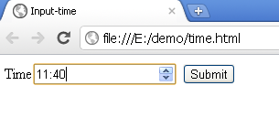
Input type – Date pickers – time
<input type="time" name="Time" min="11:40" max="18:30">
Allows entry and validation of a valid time
Notes:
min = time
The expected lower bound for the element’s value.
Examples:
23:20:50.52
17:39:57
max = time
The expected upper bound for the element’s value.
Examples:
23:20:50.52
17:39:57
149
149

Slide 150
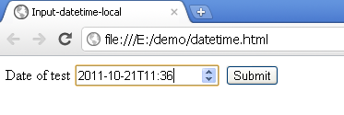
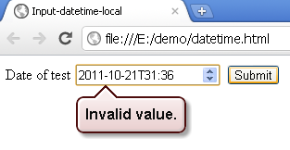
Input type – Date pickers – datetime-local
<input type="datetime-local" name="setdate" />
It creates a combined date/time input field
The value is an ISO formatted date and time
Notes:
150
150

Slide 151
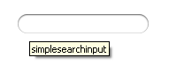
Input type - Search
<input type="search" name="Search">
It is used for search fields, like a site search, or Google search
The difference between search and text type is only stylistic
It takes the operating system’s default rounded-corners style for search
Currently Google Chrome does not support this
Notes:
This input type expects a search term. In Safari this adds a history of recent results, using the results=n attribute. The difference between search and text type is only stylistic, and in Safari on the Mac, it takes the operating system’s default rounded-corners style for search.
151

Slide 152


Input type - Color
Color <input type="color" name="Color" required>
Used to create a color control for selecting a color value
The Opera browser will allow you to select a color from a color picker
Color<input type="color" name="Color" required>
In Opera 11.52
In Google chrome 14.0
Notes:
<input type=“color” name=“get_color” value=“#000000”>
value attribute of color
-------------------------
value = simple color
A string representing a color.
A string exactly seven characters long, consisting of the following parts, in exactly the following order:
A "#" character.
Six characters in the range 0–9, a–f, and A–F.
Color keywords (for example, strings such as “red” or “green”) are not allowed
152
152

Slide 153
HTML 5 Form Elements
New Form elements added to HTML 5 are
<datalist> - A list of options for input values
<output> - For different types of output, such as output written by a script

Slide 154
HTML Form Attributes
New Form Attributes
autocomplete
novalidate
New Input Attributes
autocomplete
autofocus
form
formoverrides
height and width
list
min,max and step
multiple
pattern (regexp)
placeholder
required

Slide 155
Autocomplete attributes
The autocomplete attribute instructs the browser to remember field values
It work with <form> and the following input types
text, search, url, telephone, email, password, date pickers, range and color
It can have two values on and off
When the user starts to type in an auto complete field the browser should display options to fill in the field
Enabling Auto-Completion for a Form Field
<input type="text" name="Username" autocomplete="on" />
Disabling Auto-Completion for a Sensitive Form Field
<input type="text" name="CreditCardNumber" autocomplete="off" />

Slide 156

Autocomplete attribute (Contd.).
<form action="/webapp/demo1" method="get" autocomplete="on">
First name: <input type="text" name="fname" /><br />
Last name: <input type="text" name="lname" /><br />
E-mail: <input type="email" name="email" autocomplete="off" /><br />
<input type="submit" />
</form>

Slide 157

autofocus attribute
It specifies that a field should automatically get focus when a page is loaded
This attribute works with all <input> types
First name: <input type="text" name="fname" autofocus="autofocus" />

Slide 158

list attribute
The list attribute specifies a datalist for an input field
A datalist is a list of options for an input field
The list attribute works with the following <input> types
text, search, url, telephone, email, date pickers, number, range, and color
Url: <input type="text" list="url_list" name="url" />
<datalist id="url_list">
<option label="gmail" value="http://www.gmail.com" />
<option label="Google" value="http://www.google.com" />
<option label="Microsoft" value="http://www.microsoft.com" />
</datalist>
Notes:
<!DOCTYPE html>
<html>
<body>
<form action="color.jsp" method="get">
Url: <input type="text" list="url_list" name="url" />
<datalist id="url_list">
<option label="gmail" value="http://www.gmail.com" />
<option label="Google" value="http://www.google.com" />
<option label="Microsoft" value="http://www.microsoft.com" />
</datalist>
<input type="submit" />
</form>
</body>
</html>

Slide 159
list Attribute and the datalist Element
The list attribute provides another mechanism for auto-completion.
Whereas the autocomplete attribute instructs the browser to suggest values based on historical entries that the browser itself manages, the list attribute gives the web developer more control over the suggestions.
A list of pre-defined values can be specified in a datalist element somewhere on the page, and referenced by any text field.
The browser then uses the pre-defined values as suggestions when the user fills the text field.
To specify the suggestions made available by a datalist element, use option elements.
The value of the list attribute is the ID of the datalist element. A datalist element contains option elements representing its values.
Notes:
The list attribute and its corresponding datalist element
<input type="text" name="country" list="countries" />
<datalist id="countries">
<option value="Canada" />
<option value="England" />
<option value="France" />
<option value="Germany" />
<option value="Japan" />
<option value="Russia" />
<option value="United States" />
</datalist>
Data List option Elements with Text Content
<input type="text" name="country" list="countries" />
<datalist id="countries">
<option>United States</option>
<option>Canada</option>
<option>England</option>
<option>France</option>
<option>Germany</option>
<option>Russia</option>
<option>Japan</option>
</datalist>

Slide 160

Usability Attributes
<input type="text" placeholder="Enter your full name" name="FullName" />
<input type="text" name="FullName" autofocus="autofocus" />
<input type="text" name="Username" autocomplete="on" />

Slide 161

<datalist> form element
It is used for providing an "autocomplete" feature on form elements
It enables the user to provide a list of predefined options as they input data
The <datalist> tag is used with the <input> tag using list attribute
Enter Your title:
<input type="text" list="title" />
<datalist id="title">
<option value="Mr.">
<option value="Mrs.">
</datalist>
Notes:
<!DOCTYPE html>
<html>
<head>
<title>Example of datalist Tag</title>
</head>
<body>
Enter Your title:
<input type="text" list="title" />
<datalist id="title">
<option value="Mr.">
<option value="Mrs.">
</datalist>
</body>

Slide 162

<output> form element (Contd.).
It is used for displaying the result of calculation on the browser
Multiplication of two number
<output name="result">
</output>
Notes:
<!doctype html >
<html ><head>
<title>Document title.</title>
<script type="text/javascript">
function multi()
{
a=parseInt(prompt("Enter first number.",0));
b=parseInt(prompt("Enter first number.",0));
document.forms["form"]["result"].value=a*b;
}
</script></head>
<body onload="multi()">
<form action="" method="get" name="form">
<label>Multiplication of two number:</label>
<output name="result">
</output> </form></body>
</html>

Slide 163
form attribute
In an HTML page there can be many number of forms but only one form can be submitted
HTML 5 allows an element to use the form attribute and specify the form to which it belongs to
<form action="http://localhost:10000/webApp/default.aspx" method="get" id="user_form">
First name:<input type="text" name="fname" />
<input type="submit" />
</form>
Last name: <input type="text" name="lname" form="user_form" />
Notes:
On one page multiple forms can be located, but only one form can be submitted. Only those elements are submitted which are situated inside of the form element (in between opening and closing form tag). This means that an element located outside the form is not submitted to server for processing.
By help of attribute form it is possible to specify that an element is part of the form even if code of element is situated outside the form code. The attribute value specifies the form id to which the element belongs. The element may be assigned into multiple forms simultaneously. Then value of attribute form contains the list of all the forms (space separated). Matching is done by using the form ID as shown in the following code sample:
<form action=“/jsp/welcome.jsp" method="get" id="user_form">
First name:<input type="text" name="fname" />
<input type="submit" />
</form>
Last name: <input type="text" name="lname" form="user_form" />

Slide 164
form attribute
<form action="http://localhost:10000/webApp/default1.aspx" method="get" id="user_form2">
Qualification:<input type="text" name="qualification" form="user_form"/>
<input type="submit" /></form>
Notes:
On one page multiple forms can be located, but only one form can be submitted. Only those elements are submitted which are situated inside of the form element (in between opening and closing form tag). This means that an element located outside the form is not submitted to server for processing.
By help of attribute form it is possible to specify that an element is part of the form even if code of element is situated outside the form code. The attribute value specifies the form id to which the element belongs. The element may be assigned into multiple forms simultaneously. Then value of attribute form contains the list of all the forms (space separated). Matching is done by using the form ID as shown in the following code sample:
<form action=“/jsp/welcome.jsp" method="get" id="user_form">
First name:<input type="text" name="fname" />
<input type="submit" />
</form>
Last name: <input type="text" name="lname" form="user_form" />

Slide 165



form attribute (Contd.).
It works like this in an unsupported browser
Output in a browser with form attribute support

Slide 166
formoverrides attribute
It allows you to override some of the attributes set for the form element
The various form override attributes are:
formaction – It overrides the form action attribute
formmethod – It overrides the form method attribute
formnovalidate – It overrides the form novalidate attribute
formtarget – It overrides the form target attribute
The form override attributes works with the following <input> types
submit and image

Slide 167
formaction attribute
It overrides the form action attribute
<form action=“/WebApp/user.aspx" method="get">
Email: <input type="email" name="userid">
<input type="submit“ value=“user”>
<input type="submit" formaction=“/WebApp/admin.aspx" value=“admin">
</form>
If the user clicks the user button it submits the form to user.aspx
If the user clicks the admin button it submits the forms to admin.aspx

Slide 168
formmethod attribute
Helps to override the form method attribute (get / post)
<form action=“one.aspx" method="get">
FName: <input type="text" name="firstname" /><br />
LName: <input type="text" name="lastname" /><br />
<input type="submit" value="Submit" />
<input type="submit" formmethod="post"formaction=“two.aspx" value="Submit using POST" />
</form>

Slide 169


formnovalidate attribute
<form action=“demo.aspx" method="get">
E-mail: <input type="email" name="userid">
<input type="submit">
<input type="submit" formnovalidate="true" value="Submit without validation">
</form>
Doesn’t validate
Notes:
The novalidate and formnovalidate content attributes are boolean attributes. If present, they indicate that the form is not to be validated during This attribute is useful to include "save" buttons on forms that have validation constraints, to allow users to save their progress even though they haven't fully entered the data in the form.

Slide 170
formtarget attribute
Used to override the target attribute of the form element
<input formtarget="_blank|_self|_parent|_top|framename" />
_blank | Submits the form to a document in a new window or tab
_self | Submits the form to a document in the same frame (this is default)
_parent | Submits the form to a document in the parent frame
_top | Submits the form to a document in the full body of the window
framename | Submits the form to a document in a named iframe
Notes:
<!DOCTYPE html>
<html>
<body>
<form action="demo1.jsp" method="get">
First name: <input type="text" name="fname" /><br />
Last name: <input type="text" name="lname" /><br />
<input type="submit" value="Submit" />
<input type="submit" formtarget="_blank" value="Submit to a new window/tab" />
</form>
</body>
</html>

Slide 171
formtarget attribute (Contd.).
<form action="demo1.aspx" method="get">
First name: <input type="text" name="firstname" />
<br />
Last name: <input type="text" name="lastname" />
<br />
<input type="submit" value="Submit" />
<input type="submit" formtarget="_blank"
value="Submit to a new window/tab" />
</form>

Slide 172


height and width attribute
height - specifies the height of the image
width - specifies the width of the image
<input type="image" src="q-mark.gif" />
<input type="image" src="q-mark.gif" height="50" width="50" />

Slide 173

min, max and step attribute
max – used to specify the maximum value allowed for the input field
min - used to specify the minimum value allowed for the input field
step - specifies the legal number intervals for the input field (if step="4", legal numbers could be -4,0,4,8, etc)
The min, max, and step attributes works with the following <input> types
date pickers, number, and range
Points: <input type="number" name="pts" min="0" max="10" step="3"/>
Notes:
<!DOCTYPE html>
<html>
<body>
<form action="/servlet/demo" method="get">
Points: <input type="number" name="points" min="0" max="10" step="3"/>
<input type="submit" />
</form>
</body>
</html>

Slide 174



min,max and step attribute (Contd.).
Points: <input type="number" name="pts" min="0" max="10" step="3"/>
Valid input

Slide 175


multiple attribute
The multiple attribute is used to indicate if the user can be allowed to specify more than one value
Email - To: <input type="email" name="to" />
Email - CC: <input type="email" name="cc" multiple />
Notes:
<!DOCTYPE html>
<html>
<body>
<form action="/servlet/demo">
Email - TO: <input type="email" name="To"/><br/>
Email - CC: <input type="email" name="cc" multiple /><br/>
<input type="submit" />
</form>
</body>
</html>

Slide 176


pattern attribute
The pattern attribute is used to specify a pattern to validate an input field
The pattern is a regular expression
The pattern attribute works with the following <input> types
text, search, url, telephone, email, and password
<input type="text" pattern="[0-9]{6}" name="pincode" placeholder="A pincode is a 6 digit number"/>

Slide 177

placeholder attribute
It provides description about the expected value of an input field
It works with the following <input> types
text, search, url, telephone, email, and password
The hint is displayed in the input field when it is empty, and disappears when the field gets focus
<input type="search" name="usr_search" placeholder="Search entire wipro site" />

Slide 178

required attribute
The required attribute specifies that an input field must be filled out before submitting
It works with the following <input> types
text, search, url, telephone, email, password, date pickers, number, checkbox, radio, and file
Name: <input type="text" name="user_name" required="required" />
Notes:
<!DOCTYPE html>
<html>
<body>
<form action="/servlet/demo" method="get">
Name: <input type="text" name="user_name" required="required" />
<input type="submit" />
</form>
</body>
</html>

Slide 179
Cross-Browser Interoperability
One of the main problems with earlier versions of HTML was cross-browser interoperability
Developers strive for code that will work in all browsers
This is impossible because of legacy browsers and the difference between browser engines

Slide 180
Browser Detection
A technique to check which browser is running the code
Can make dozens of assumptions based on this single check
Should be avoided most of the time
Should only be used when applying code to a specific legacy browser of a known version
<!--[if IE 7]><div>rendered in Internet Explorer 7 only</div><![endif]-->

Slide 181
Feature Detection
A technique to check the availability of a feature before it is used
Standard features should be looked for first
Browsers sometimes support both the standards and a legacy implementation
Looking for standart features first will ensure the use of standards if available
Avoid making any assumptions about existing features
if (window.addEventListener) {
// HTML that will be rendered if addEventListener is available
}
else {
// HTML that will be rendered if addEventListener is not available
{

Slide 182
Modernizr
A small JavaScript library
Detects availability of HTML5 and CSS3 specifications and whether features are natively implemented in the browser
Uses feature detection under the hood
if (Modernizr.canvas) {
// HTML that will be rendered if the Canvas element is available
}

Slide 183
Summary
Describe the new HTML5 input types.
Apply date pickers on webpages.
Use the new text box types on webpages.
Use the new interactive text box types on webpages.

Slide 184

Before Web Workers

Slide 185
Web Workers
When executing scripts in an HTML page, the page becomes unresponsive until the script is finished.
A web worker is a JavaScript that runs in the background, independently of other scripts, without affecting the performance of the page.
You can continue to do whatever you want: clicking, selecting things, etc., while the web worker runs in the background.

Slide 186
Web Workers for which scenarios?
image processing by using the data extracted from the <canvas> or the <video> elements. You can divide the image into several zones and push them to the different Workers that will work in parallel. You’ll then benefit from the new generation of multi-cores CPUs. The more you have, the faster you’ll go.
big amount of data retrieved that you need to parse after an XMLHTTPRequest call. If the time needed to process this data is important, you’d better do it in background inside a Web Worker to avoid freezing the UI Thread. You’ll then keep a reactive application.

Slide 187
Web Workers for which scenarios?
background text analysis: as we have potentially more CPU time available when using the Web Workers, we can now think about new scenarios in JavaScript. For instance, we could imagine parsing in real-time what the user is currently typing without impacting the UI experience. Think about an application like Word (of our Office Web Apps suite) leveraging such possibility: background search in dictionaries to help the user while typing, automatic correction, etc.
concurrent requests against a local database. IndexDB will allow what the Local Storage can’t offer us: a thread-safe storage environment for our Web Workers.

Slide 188
Types of Web Workers
Dedicated Workers
Shared Workers

Slide 189
Types of Web Workers
Dedicated Workers
A dedicated worker is accessible from the parent script that created it
Wide browser support: All
It is simply tied to its main connection

Slide 190
Types of Web Workers
Shared Workers
A shared worker can be accessed from any script of the same origin.
Limited browser support: Chrome 4.0+, Safari 5.0+ and Opera 10.6+.
It can work with multiple connections.

Slide 191
CSS FUNDAMENTALS FOR ADVANCED USE
A CSS (cascading style sheet) file allows you to separate your web sites (X)HTML content from it's style.
As always you use your (X)HTML file to arrange the content, but all of the presentation (fonts, colors, background, borders, text formatting, link effects & so on...) are accomplished within a CSS.

Slide 192
Internal Stylesheet
<head>
<title><title>
<style type="text/css">
CSS Content Goes Here
</style>
</head>
<body>

Slide 193
External style sheets
Here are a few reasons this is better.
Easier Maintenance
Reduced File Size
Reduced Bandwidth
Improved Flexibility

Slide 194

CSS Syntax

Slide 195
CSS Syntax
selector { property: value }
body {
background: #eeeeee;
font-family: "Trebuchet MS", Verdana, Arial, serif;
}
p { color:red; /*This is another comment*/ text-align:center; }

Slide 196

Understanding Style Sheets

Slide 197
CSS Selectors
Element Selector
p { text-align:center; color:red; }
Id Selector
#para1 { text-align:center; color:red; }

Slide 198
CSS Selectors
class Selector
.center { text-align:center; color:red; }
p.center { text-align:center; color:red; }

Slide 199
CSS Background
CSS properties used for background effects:
background-color
background-image
background-repeat
background-attachment
background-position

Slide 200
CSS Background
body {background-color:#b0c4de;}
h1 {background-color:#6495ed;} p {background-color:#e0ffff;} div {background-color:#b0c4de;}
body {background-image:url("paper.gif");}
body { background-image:url("gradient2.png"); background-repeat:repeat-x; }

Slide 201
CSS Text
h1 {text-align:center;} p.date {text-align:right;} p.main {text-align:justify;}
h1 {text-decoration:overline;} h2 {text-decoration:line-through;} h3 {text-decoration:underline;}
p.uppercase {text-transform:uppercase;} p.lowercase {text-transform:lowercase;} p.capitalize {text-transform:capitalize;}
p {text-indent:50px;}

Slide 202
CSS Font
p{font-family:"Times New Roman", Times, serif;}
p.normal {font-style:normal;} p.italic {font-style:italic;} p.oblique {font-style:oblique;}
h1 {font-size:40px;} h2 {font-size:30px;} p {font-size:14px;}
h1 {font-size:2.5em;} /* 40px/16=2.5em */ h2 {font-size:1.875em;} /* 30px/16=1.875em */ p {font-size:0.875em;} /* 14px/16=0.875em */

Slide 203
CSS Links
The four links states are:
a:link - a normal, unvisited link
a:visited - a link the user has visited
a:hover - a link when the user mouses over it
a:active - a link the moment it is clicked

Slide 204
CSS Links
a:link {color:#FF0000;} /* unvisited link */ a:visited {color:#00FF00;} /* visited link */ a:hover {color:#FF00FF;} /* mouse over link */ a:active {color:#0000FF;} /* selected link */

Slide 205
CSS Float
img { float:right; }
.thumbnail { float:left; width:110px; height:90px; margin:5px; }

Slide 206

CSS Box Model

Slide 207
CSS Box Model
#buttonfld
{
background-color:green;
width:600px;
padding:10px;
border:5px solid gray;
margin:0px;
}

Slide 208
Creating a Transparent Image
img { opacity:0.4; filter:alpha(opacity=40); /* For IE8 and earlier */ }
img:hover { opacity:1.0; filter:alpha(opacity=100); /* For IE8 and earlier */ }

Slide 209
Creating a Transparent Image
div.background { width:500px; height:250px; background:url(klematis.jpg) repeat; border:2px solid black; } div.transbox { width:400px; height:180px; margin:30px 50px; background-color:#ffffff; border:1px solid black; opacity:0.6; filter:alpha(opacity=60); /* For IE8 and earlier */ } div.transbox p { margin:30px 40px; font-weight:bold; color:#000000; }

Slide 210
Combining Selectors
h1, h2, h3, h4, h5, h6 {
color: #009900;
font-family: Georgia, sans-serif;
}

Slide 211
Inheritance
body {font-family: Verdana, serif;}
h1 {font-family: Georgia, sans-serif;}
p {font-family: Tahoma, serif;}

Slide 212
CSS Classes
<p>
To put it more simply, this
<span class="greenboldtext">sentence</span>
you are reading is styled in my CSS file by the following.
</p>
.greenboldtext{
font-size: small;
color: #008080;
font-weight: bold;
}

Slide 213
CSS IDs
<div id="container">
Everything within my document is inside this division.
</div>
#container{
width: 80%;
margin: auto;
padding: 20px;
border: 1px solid #666;
background: #ffffff;
}

Slide 214

CSS Margins

Slide 215

CSS Margins

Slide 216
CSS Margins
margin-top: length percentage or auto;
margin-left: length percentage or auto;
margin-right: length percentage or auto;
margin-bottom: length percentage or auto;
margin: 10px 10px 10px 10px;
If you declare all 4 values as I have above, the order is as follows:
1. top
2. right
3. bottom
4. left

Slide 217
CSS Margins
If only one value is declared, it sets the margin on all sides.
margin: 10px;
If you only declare two or three values, the undeclared values are taken from the opposing side.
margin: 10px 10px; /* 2 values */
margin: 10px 10px 10px; /* 3 values */
If you do not declare the margin value of an element, the margin is 0 (zero).

Slide 218
CSS Margins
You can see in the example below, the elements for this site are set to be 20px (pixels) from the body.
body{
margin: 20px;
background: #eeeeee;
font-size: small;
font-family: Tahoma, Arial, "Trebuchet MS", Helvetica, sansserif;
text-align: left;
}

Slide 219
CSS Padding
Padding is the distance between the border of an (X)HTML element and the content within it.
padding-top: length percentage;
padding-left: length percentage;
padding-right: length percentage;
padding-bottom: length percentage;

Slide 220
CSS Text Properties
letter-spacing: value;
text-align: value;
color: value;
text-decoration: value;
Possible values are
none
underline
overline
line through
blink

Slide 221
CSS Text Properties
text-transform: value;
Possible values are
none
capitalize
lowercase
Uppercase
word-spacing: value;

Slide 222
CSS Font Properties
The font property can set the style, weight, variant, size, line height and font:
font: italic bold normal small/1.4em Verdana, sans-serif;
Font-Family
You can set what font will be displayed in an element with the font-family property.
There are 2 choices for values:
family-name
generic family
If you set a family name it is best to also add the generic family at the end. As this is a priortized list. So if the user does not have the specified font name it will use the same generic family. (see below)
font-family: Verdana, sans-serif;

Slide 223
Font Size
You can set the size of the text used in an element by using the font-size property.
font-size: value;
There are a lot of choices for values:
xx-large
x-large
larger
large
medium
small
smaller
x-small
xx-small
length
% (percent)

Slide 224
Font Style
You can set the style of text in a element with the font-style property
font-style: value;
Possible values are
normal
itailc
oblique

Slide 225
CSS Anchors, Links and Pseudo Classes
a:link {color: #009900;} a:visited {color: #999999;} a:hover {color: #333333;} a:focus {color: #333333;} a:active {color: #009900;}

Slide 226
CSS Backgrounds
Background
You can style the background of an element in one declaration with the background property.
background: #ffffff url(path_to_image) top left no-repeat fixed;
Values:
attachment
color
image
position
repeat

Slide 227
Background Attachment
If you are using an image as a background. You can set whether the background scrolls with the page or is fixed when the user scrolls down the page with the background-attachment property
background-attachment: value;
Values:
fixed
scroll

Slide 228
Background Color
You can specifically declare a color for the background of an element using the background-color property.
background-color: value;
Values:
color name
hexadecimal number
RGB color code
transparent

Slide 229
Background Image
You can set an image for the background of an element using the background-image property.
background-image: url(path_to_image);
Values:
url
none

Slide 230
Background Position
You can position an image used for the background of an element using the background-position property.
background-position: value;
Values:
top left
top center
top right
center left
center center
center right
bottom left
bottom center
bottom right
x-% y-%
x-pos y-pos

Slide 231
Background Repeat
You can set if an image set as a background of an element is to repeat (across=x and/or down=y) the screen using the background-repeat property.
background-repeat: value;
Values:
no-repeat
repeat
repeat-x
repeat-y

Slide 232
CSS Borders
You can set the color, style and width of the borders around an element in one declaration by using the border property.
border: 1px solid #333333;
Values:
color
style
width

Slide 233
Border Color
You can set the color of a border independently with the border-color property.
border-color: value;
Values:
color name
hexadecimal number
RGB color code
transparent

Slide 234
Border Style
You can set the style of a border independently with the border-style property.
border-style: value;
Values:
dashed
dotted
double
groove
hidden
inset
none
outset
ridge
solid

Slide 235
CSS Ordered & Unordered Lists
List Style
You can control the appearance of ordered and unordered lists in one declaration with the list-style property
list-style: value value;
Values:
image
position
type

Slide 236
List Style Type
list-style-type: value;
Values
disc
circle
square
decimal
lower-roman
upper-roman
lower-alpha
upper-alpha
none

Slide 237
Display
You can control how an element is displayed with the display property
display: value;
Values:
block
inline
list-item
none
Now, what does all that mean?
Block
Creates a line break before and after the element
Inline
No line break is created
List Item
Creates a line break before and after the element and adds a list item marker
None
Makes an element not display on the page

Slide 238
Float
The float property changes how text and or images within an element are displayed
float: value;
Values:
left
right
none
Now, what does all that mean?
Left
The image/text is displayed to the left of the parent element
Right
The image/text is displayed to the right of the parent element
None
There is no change in the way the image/text is displayed

Slide 239
Overflow
You can control what an elements contents will do if it overflows it boundaries with the overflow property
overflow: value;
Values:
auto
hidden
visible
scroll

Slide 240
Visibility
You can control if an element is visible or not with the visibility property
visibility: value;
Values:
hidden
visible

Slide 241
Z-Index
You can control the layer order of positioned elements with the z-index property
z-index: value;
Values:
auto
number
The higher the number the higher the level. Negative numbers are allowed

Slide 242
CSS 3 Features
Border Radius
#my_id { height: 100px; width: 100px; border: 1px solid #FFF; /* For Mozilla: */ -moz-border-radius: 15px; /* For WebKit: */ -webkit-border-radius: 15px; }
div { border:2px solid; border-radius:25px; }

Slide 243
CSS 3 Features
Property | IE | chrome | firefox | safari | opera
border-radius | 9.0 | 5.0 4.0 -webkit- | 4.0 3.0 -moz- | 5.0 3.1 -webkit- | 10.5
box-shadow | 9.0 | 10.0 4.0 -webkit- | 4.0 3.5 -moz- | 5.1 3.1 -webkit- | 10.5
border-image | 11.0 | 16.0 4.0 -webkit- | 15.0 3.5 -moz- | 6.0 3.1 -webkit- | 15.0 10.5 -o-

Slide 244
CSS 3 Features
Border Images
#my_id { /* url, top image, right image, bottom image, left image */ border-image: url(border.png) 30 30 30 30 round round; }

Slide 245
CSS 3 Features
Box Shadow
#my_id { background: #FFF; border: 1px solid #000; /* For Mozilla: */ -moz-box-shadow: 5px #999; /* For WebKit: */ -webkit-box-shadow: 5px #999; }

Slide 246
CSS 3 Features
Multi-Column Layout
#my_id {text-size: 12px; /* For Mozilla: */ -moz-column-gap: 1em; -moz-column-rule: 1px solid #000; -moz-column-count: 3; /* For WebKit: */ -webkit-column-gap: 1em; -webkitcolumn-rule: 1px solid #000; -webkit-column-count: 3; }

Slide 247
CSS 3 Features
Multiple Backgrounds
#my_id { background: url(topbg.jpg) top left no-repeat, url(middlebg.jpg)center left no-repeat, url(bottombg.jpg) bottom left no-repeat; }

Slide 248
CSS 3 Features
@font-face
@font-face { font-family: “my-font”; src: url(my-font.tff) format(“truetype”); }
#my_id { font-family: “my-font”, sans-serif; }

Slide 249
CSS 3 Features
Attribute Selectors
p[title^=t] { /* Attributes to give them. */ }

Slide 250
CSS 3 Features
:nth-child() and :nth-of-type()
p:nth-child(3n+1) { background: #F00; }
/* First, Fourth, Seventh, etc..
/*
Only li elements */
p li:nth-of-type(3n+1) { background: #F00; }

Slide 251
CSS 3 Features
Opacity
#my_id { background: #F00; opacity: 0.5; }

Slide 252
CSS 3 Features
RGBA Colors
#my_id { background: rgba(255, 212, 45, 0.5); }

Slide 253
CSS 3 Features
RGBA Colors
#my_id { background: rgba(255, 212, 45, 0.5); }

Slide 254
CSS3 2D Transforms
translate()
rotate()
scale()
skew()
matrix()

Slide 255
Transition properties
transition-property: width; transition-duration: 1s; transition-timing-function: linear; transition-delay: 2s;

Slide 256
CSS3 2D Transforms
div { -ms-transform: translate(50px,100px); /* IE 9 */ -webkit-transform: translate(50px,100px); /* Chrome, Safari, Opera */ transform: translate(50px,100px); }

Slide 257
CSS3 2D Transforms
div { -ms-transform: rotate(30deg); /* IE 9 */ -webkit-transform: rotate(30deg); /* Chrome, Safari, Opera */ transform: rotate(30deg); }

Slide 258
CSS3 2D Transforms
div { -ms-transform: scale(2,4); /* IE 9 */ -webkit-transform: scale(2,4); /* Chrome, Safari, Opera */ transform: scale(2,4); }

Slide 259
CSS3 2D Transforms
div { -ms-transform: skew(30deg,20deg); /* IE 9 */ -webkit-transform: skew(30deg,20deg); /* Chrome, Safari, Opera */ transform: skew(30deg,20deg); }

Slide 260
CSS3 2D Transforms
div { -ms-transform:matrix(0.866,0.5,-0.5,0.866,0,0); /* IE 9 */ -webkit-transform:matrix(0.866,0.5,-0.5,0.866,0,0); /* Chrome, Safari, Opera */ transform:matrix(0.866,0.5,-0.5,0.866,0,0); }

Slide 261
CSS3 3D Transforms
The rotateX() Method
div { -webkit-transform: rotateX(120deg); /* Chrome, Safari, Opera */ transform: rotateX(120deg); }

Slide 262
CSS3 3D Transforms
The rotateY() Method
div { -webkit-transform: rotateY(130deg); /* Chrome, Safari, Opera */ transform: rotateY(130deg); }

Slide 263

The nature of output: grouping output with CSS media types

Slide 264
Introduction to Jquery & Syntax

Slide 265
Objectives
At the end of this module you will understand
What is jQuery?
jQuery Features
How jQuery Works
Downloading jQuery Library
Using jQuery Library
Basic jQuery Example

Slide 266
What is jQuery?
jQuery is an open-source library of JavaScript functions
jQuery project started in 2006 by John Resig
jQuery helps you to easily & quickly write clean JavaScript
The jQuery library contains many common functions & plug-ins that you can extend immediately. For example:
Applying styles on HTML DOM elements on-the-fly
Use AJAX out-of-the-box
Add date picker, auto-complete, progress bar, menu tabs to your forms
Make animations almost as good as Flash can

Slide 267
JQuery
jQuery is a fast, lightweight JavaScript library that is CSS3 compliant and supports many browsers.
The jQuery framework is extensible and very nicely handles DOM manipulations, CSS, AJAX, Events and Animations.
JavaScript is a language whereas jQuery is a library written using JavaScript.

Slide 268

Why jQuery?
Consider that we have to apply zebra-stripes on a table with many rows
This can be achieved by either using CSS or JavaScript
Using CSS has an immediate fall-out – Row Consistency
A typical JavaScript function will require about a few dozen lines of code and could look something like this:

Slide 269
Zebra-striping with JavaScript
var stripe = function() {
var tables = document.getElementsByTagName("table");
for(var x=0;x!=tables.length;x++){
var table = tables[x];
if (! table) { return; }
var tbodies = table.getElementsByTagName("tbody");
for (var h = 0; h < tbodies.length; h++) {
var even = true;
var trs = tbodies[h].getElementsByTagName("tr");
for (var i = 0; i < trs.length; i++) {
this.className += " ruled"; return false
if(even) trs[i].className += " even";
even = !even;
}
}
}
}
window.onload = stripe;

Slide 270
Zebra-striping with jQuery
$("tr:nth-child(even)").css('background-color','coral');

Slide 271
What does jQuery do?
Crunches JavaScript
reduces the number of lines of JavaScript you would have to write, call it shortcut JavaScript
Manipulate HTML
allows you to select & manipulate HTML, popularly used to manipulate <form> elements
Manipulate CSS
allows you to apply, remove or change CSS properties applied on HTML elements, on-the-fly
Out-of-the-box widgets
includes many commonly needed widgets. For example, calendar popups, accordion, tab panels, etc
Animation
apply animated effects like show, hide, slide on HTML elements. Also includes some very cool animation effects on images.

Slide 272
Downloading jQuery Library
Download the latest release of the library from jQuery.com
2 versions are available – minified & uncompressed
Alternatives to downloading:
Google CDN:
<head>
<script type="text/javascript" src="http://ajax.googleapis.com/ajax/libs/jquery/1.4.2/jquery.min.js"></script>
</head>
Microsoft CDN:
<head>
<script type="text/javascript" src="http://ajax.microsoft.com/ajax/jquery/jquery-1.4.2.min.js"></script>
</head>
Notes:
Content Delivery Network (CDN)

Slide 273
Basic jQuery Usage Example
<html>
<head>
<script type="text/javascript" src="myJsPath/jquery.js"></script>
<script type="text/javascript">
$(document).ready(function(){
$("button").click(function(){
$("p").hide();
});
});
</script>
</head>
<body>
<h2>This is a heading</h2>
<p>This is a paragraph.</p>
<p>This is another paragraph.</p>
<button>Click me</button>
</body>
</html>
Add the jQuery library file in
the head section

Slide 274
How does jQuery work?
jQuery works first by “Selecting” the HTML element(s) and then applying your “Action” on it
To select and apply action, use the jQuery object
The jQuery object can also be called using $
Example:
// Select all elements of class: "someClass" and
// apply a red border to all of them
jQuery(".someClass").css("border", "1px solid red");
// Exactly the same as above, but using $
$(".someClass").css("border", "1px solid red");
Notes:
In JavaScript, a declared function is by default a class and can be instantiated using the new operator
$ is the identifier name for the jQuery object

Slide 275
jQuery Syntax - $() Factory
All types of selectors in jQuery start with $()
The syntax is $(selector).action()
The $ sign defines jQuery
A selector to “query or find” HTML elements
A jQuery action() to perform on the HTML elements
Examples:
$(this).hide → hides current element
$(“p”).hide → hides all paragraphs
$(“p.test”).hide → hides all paragraphs with class=“test”
$(“#test”).hide → hides the element with id=“test”

Slide 276
jQuery Chaining
To apply more than one action to a set of “selected” elements, you can chain it
Example:
$('img').clone().appendTo('#previews').addClass('beenCloned');
Note that while chaining, each action is performed only after the previous has completed

Slide 277
The Document Ready Function
$(document).ready(function(){
// jquery function go here…
});
This method of writing function, prevents the jQuery function from running before the document is finished loading (is ready)
Note: It is not mandatory to write jQuery statements within this construct
Notes:
Most jQuery functions that you want to run after the document (page) is loaded, use this construct.
Examples of actions that can fail if functions are run before the document is fully loaded:
Trying to hide an element that doesn't exist
Trying to get the size of an image that is not loaded

Slide 278
$(document).ready() function
If you want an event to work on your page, you should call it inside the $(document).ready() function.
This is to prevent any jQuery code from running before the document is finished loading (is ready).
Everything inside it will load as soon as the DOM is loaded and before the page contents are loaded.
The $(document).ready() function has some benefit for its own way to make its events to work.
First no need for "behavioral" markup tag in the HTML.
$(document).ready() helps your events to get load or fire before the window loads.
Anything that you write inside its brackets is ready as soon as the DOM is registered by the browser.

Slide 279
How to write jQuery functions
Simple function:
$(document).ready(function(){
$(“p”).hide();
}); // end document.ready
Nested function:
$(document).ready(function(){
$(“button”).click(function(){
var num1 = 10;
var num2 = 5;
var numSum = num1 + num2;
alert(“The sum is ” + numSum);
}); // end click
}); // end document.ready

Slide 280
jQuery
jQuery Syntax
The jQuery syntax is made for selecting HTML elements and perform some action on the element(s).
Syntax $(selector).action()
A dollar sign to define jQuery
A (selector) to "query (or find)" HTML elements
A jQuery action() to be performed on the element(s)

Slide 281
Summary
At the end of this sub module
What is jQuery
jQuery features
Downloading jQuery library
Including jQuery in web pages
How jQuery works
The $() and jQuery() function
jQuery chaining
The $(document).ready() function
Writing jQuery functions

Slide 282
jQuery Selectors

Slide 283
Objective
At the end of this sub module we will understand
Element Selectors
CSS Selectors
Attribute Selectors
Advanced Selectors

Slide 284
jQuery Selectors
In HTML DOM, selectors allow you to manipulate DOM elements as a group or as a single node
jQuery selectors allow you to select HTML elements (or groups of elements) by element name, attribute name or by content
Types of jQuery selectors:
Element Selectors
CSS Selectors
Attribute Selectors

Slide 285
jQuery Element Selectors
Element Selectors
jQuery uses the HTML tags to select HTML elements
Example:
$(“p”) → selects all <p> elements
$(“a”) → selects all <a> elements
$(“ul”) → selects al <ul> elements
$(“*”) → selects all elements within the document
$(“img, span”) → selects <img> and <span> elements

Slide 286
jQuery CSS Selectors
CSS Selectors
jQuery uses CSS IDs & classnames to select elements
A CSS ID is preceded with a ‘#’ & a classname with a ‘.’
Examples:
$(“#intro”) → selects the first element with id=“intro”
$(“p.intro”) → selects all <p> elements with class=“intro”
$(“a#myId.myClass”) → selects <a> with id=“myId” & class=“myClass”
$("p a.specialClass") → selects <a> with class=“specialClass” declared within <p> elements

Slide 287
jQuery Attribute Selectors
Attribute Selectors
jQuery uses XPath expressions to select elements with given attributes
To select, put the attribute with in [ ]
Examples:
$(“[href]”) → selects all elements with href attributes
$(“input[type=text]”) → selects all <input> elements with a type of text
Notes:
Attributes are parameters to HTML elements
Example: in <input type=“text”>, ‘type’ is the attribute and ‘text’ is its value
Example: in <a href=“http://google.com” target=“_blank”>, target is the attribute and _blank is its value

Slide 288
jQuery Advanced Selectors
jQuery advanced selector uses the next generation of CSS supported by Mozilla Firefox, IE 7, Chrome, Safari, etc
Examples:
$('*') → Selects all elements in the document
$(this) → Selects the current element
$("p > *") → Selects all elements that are children of <p> element
$("li:not(.myclass)") →Selects all elements matched by <li> that do not have class="myclass"
$("li > ul") → Selects all elements matched by <ul> that are children of an element matched by <li>
$("code, em, strong") → Selects all elements matched by <code> or <em> or <strong>
$("p:empty") → Selects all elements matched by <p> that have no children
$(":radio") → Selects all radio buttons in the form
$(":checked") → Selects all checked boxes in the form
$("[href!=‘#’]") → Selects all elements with href value NOT equal to “#”
$("[href^=‘http://’]") → Selects all elements with href value that starts with ‘http://’
$("[href$=‘.pdf’]") → Selects all elements with href value that ends with ‘.pdf’

Slide 289
jQuery Advanced Selectors
$("li:even") → Selects all elements matched by <li> that have an even index value
$("tr:odd") → Selects all elements matched by <tr> that have an odd index value
$("li:first") → Selects the first <li> element
$("li:last") → Selects the last <li> element
$("li:eq(2)") → Selects the third <li> element. Index starts at 0
$("li:lt(2)") → Selects all elements matched by <li> element before the third one; in other words, the first two <li> elements
$("li:gt(1)") → Selects all elements matched by <li> after the second one
$("li:first-child") → Selects all elements matched by <li> that are the first child of their parent
$("li:last-child") → Selects all elements matched by <li> that are the last child of their parent
$(":parent") → Selects all elements that are the parent of another element, including text
$("li:contains(second)") → Selects all elements matched by <li> that contain the text second
$("li:visible") → Selects all elements matched by <li> that are visible
$("li:hidden") → Selects all elements matched by <li> that are hidden
* The above examples are not limited to <li> & also apply to other elements like <p>, <img>, etc

Slide 290
jQuery Selector Usage
<html>
<head>
<title>jQuery - Selectors</title>
<script type="text/javascript" src="jsLib/jquery-1.4.2.min.js"></script>
</script>
</head>
<body>
<p id="intro">This is just a test of JQuery.</p>
<ol>
<li>Bangalore</li>
<li>Hyderabad</li>
<li>Kolkata</li>
<li>Chennai</li>
<li>Pune</li>
<li>Bhubaneswar</li>
</ol>
<p>This is how it is defined </p>

Slide 291
jQuery Selector Usage (cont'd)
<script type="text/javascript">
$(document).ready(function(){
$("p").css("background-color", "#ff9");
$("a").css("background-color","#f00");
$("p#intro").css("border","3px dashed #00f");
$("li:first").css("background-color","#66f");
$("li:contains(jQ)").css("background-color","#0f0");
});
</body></html>

Slide 292
Hands-On-Lab
Create a HTML document with:
Add the jQuery library to your HTML document using <script>
<h1> header
<p> with some content in it
An ordered list <ol> with about 6 <li> elements
Another <p> with some content in it and few of the phrases with <a> link on it
The first and the last <li> element should have the background color as red and green respectively.

Slide 293
Summary
In this session, we learnt about:
Element Selectors
CSS Selectors
Attribute Selectors
Advanced Selectors

